Slide 1
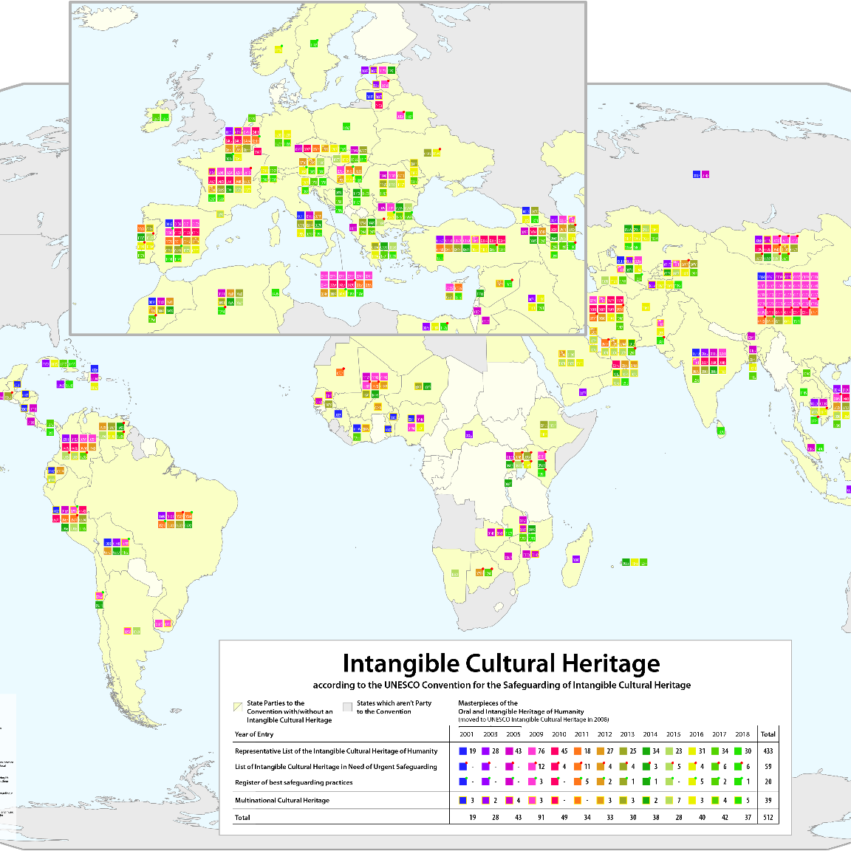
Digital Cultural Maps
Cultural Heritage Informatics Fellowship

Slide 2
Digital Heritage + Mapping
Space is part of cultural heritage
“Spatial Turn”
Spatial-ness + Temporal-ness
(Time + Space connected)
Narrative + Knowledge
Notes:
Web Mapping in Digital Heritage
Space has long been part of cultural heritage and how we experience the world
“Spatial turn” academic interest in web-based mapping often used by people who have “just discovered space” and its importance (mostly humanists)
History and culture has always been connected to space.
Michigan State’s entire history is related to the land and space around it. As the premier land-grant university and an agricultural powerhouse, MSU or Moo Yoo as some call it is intrinsically tied to the land around it.
Every single discipline has a landscape or a spatial turn
Emphasizing space and place in enquiry has opened up new questions at a vertigo inducing speed
Narratives have always been grounded in geography of the landscape - i.e. growth of railways, transportation, interstates (fun fact interstates in US were built to transport nuclear weapons)
Geography plays a part in how people organize themselves and where villages are created
Scholarship was revolutionized was by the change in scale of space - from studying the nation state to the city. Studying cities gave academics outlooks to follow back to the ancient world - cities often are older than countries.
Studying nations and cities privileges a narrative. They are relics of a time past. National boundaries are arbitrarily designated.
Time and space are often tightly connected: so much of spatial-ness is often temporal-ness. Time provides a framework within which we can work to sequence events (put them in order). It also allows us to look for causation. Space allows us to contextualize events based on location and size (local, global etc).

Slide 3
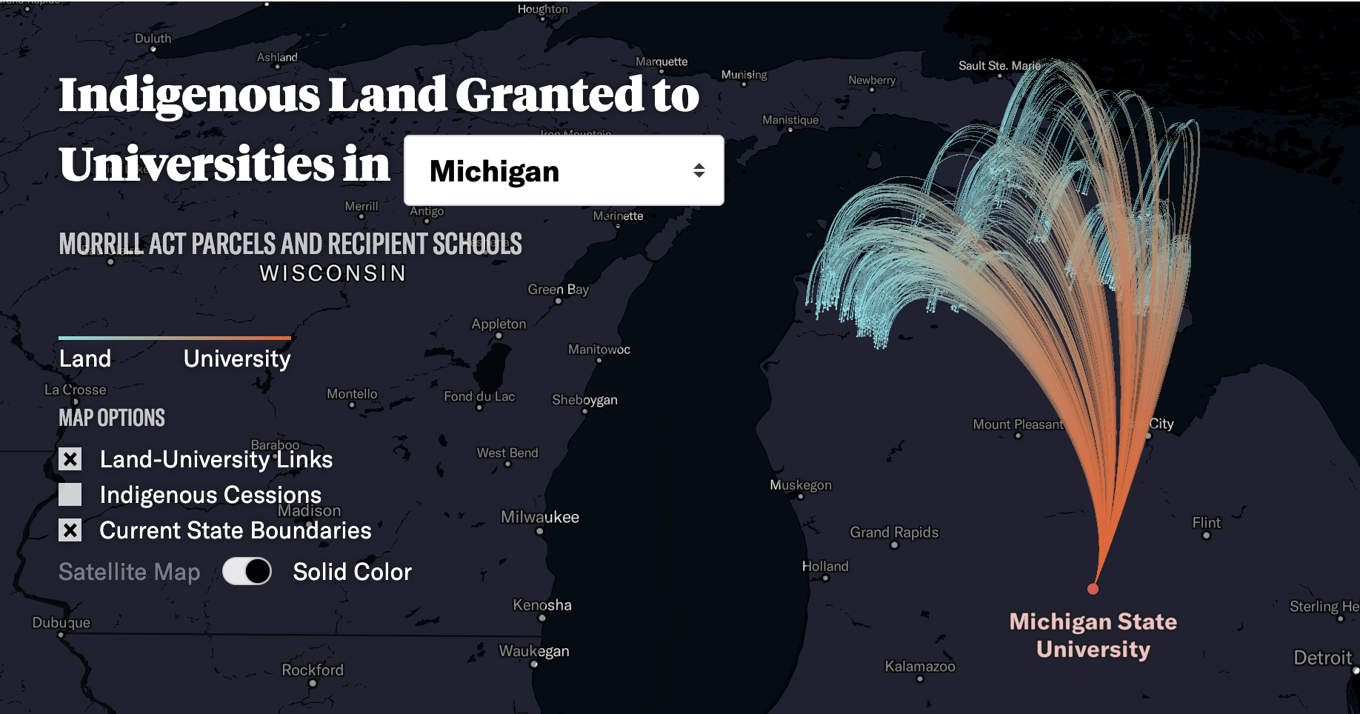
Morrill Act + Land Grant Universities
Notes:
Privileging of certain narrative resulted in quite a lot of pushback. This manifested specifically in the study of the western US. The most recent contingent of scholars link the story of modern landscape to the political and economic machinations of the age of the infrastructure state.
Modern landscape charts the modern struggles of economic and political centralization, the tensions between individuals and experts. Take the establishment of the land-grant university - it has a very geographic/spatial history but it also has a time-based linear history - indigenous peoples were forced out. But their entire history is tied to the land.
Studying space gave practitioners the options to study: context, scale, the human experience, and power structures in both a linear and non-linear fashion. How do we reconcile mapping and time with not just telling a geographic story:
Instead of just regular time and space we practice something called deep mapping now.
This technique draws on understandings of place that are personal and geographical. This helps us understand how place is connected to many different things. Unlike traditional mapping which is a process that happens top-down, deep mapping happens from bottom-up. It’s about articulating social understanding, stories of place, and relationships. This is a slower process because it often involves community input and experiences that often don’t mesh with institutional or official narratives - it amplifies disenfranchised voices.
Deep maps are discursive resources that can be designed to visualize changes in human-environmental relationships over time and to accommodate multiple voices in the creation of community-based narratives.

Slide 4
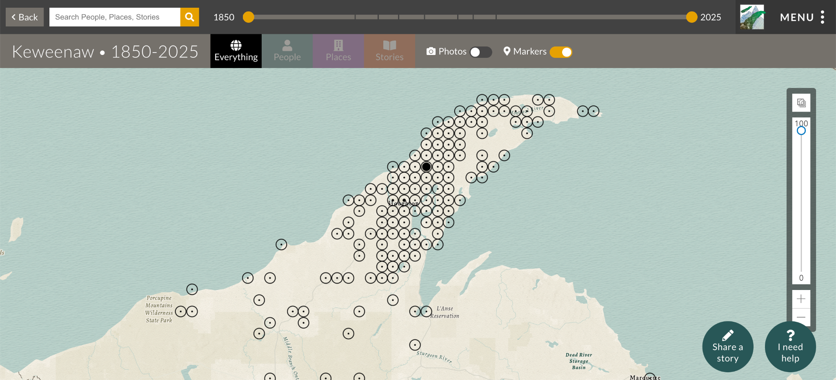
Deep Mapping
Notes:
Deep mapping is a research method that aims to comprehend the many layers of memory, experience, and perception of a particular place over time.
This technique draws on understandings of place that are personal and geographical. This helps us understand how place is connected to many different things. Unlike traditional mapping which is a process that happens top-down, deep mapping happens from bottom-up. It’s about articulating social understanding, stories of place, and relationships. This is a slower process because it often involves community input and experiences that often don’t mesh with institutional or official narratives - it amplifies disenfranchised voices.
Deep maps are discursive resources that can be designed to visualize changes in human-environmental relationships over time and to accommodate multiple voices in the creation of community-based narratives.
A Deep Map of a place includes many things: direct perceptions of that place; its inhabitants’ memories; embodied understandings as the place enters you in numerous ways that are emotional, psychological, physical, spiritual and transcendental; geological formations; more than-human actors like animals, plants, microbes and landscapes; historical developments from different eras; weather patterns; agricultural uses; modern infrastructure; bioregional processes; contradictory ideological ratiocinations and more.

Slide 5
Geospatial Web
How do web maps actually work?
Architecture
URI
Software, services, tools, protocols
It is NOT GIS
Notes:
How do web maps actually work?
They are interactive and run specifically on your browser based on tile-based rendering and zoom levels. They combine base maps with map layers. The technology is server-side communication unlike javascript because it pulls information from all around the web to display.
Basically you collect and organize data (usually in some form of readable output Javascript, JSON or GeoJSON), select a basemap and tool, your collected data then becomes the layers to put over your basemap, once you write the code the browser calls the map through javascript, and then the information is displayed and rendered.
When you interact with a web map, you're essentially viewing a specific window into an enormous pyramid of pre-generated image tiles, with JavaScript orchestrating which tiles to show and how to display your data on top of them.
Geospatial data has specific or authoritative URIs - Uniform Resource Identifiers (URI) are used to identify "resources" on the web.
Authoritative URI - a digital reference that allows you to disambiguate place names (Alexandria VA vs Alexandria (Carthage))
URIs are commonly used as targets of HTTP requests, in which case the URI represents a location for a resource, such as a document, a photo, binary data. The most common type of URI is a Uniform Resource Locator (URL)
URIs can be used to trigger behaviors other than fetching a resource, in javascript this is your “href” and <a> function.
World Historical Gazetteer is the keeper of all geographic data - https://whgazetteer.org/
Geospatial web: constellation of software, services, protocols, methods, and best practices to make the web a platform to share, display, and interact with geospatial data
Web mapping IS NOT GIS (geographical information system)
Geographic Information Systems are a type of software that allows you to visual and analyze spatial data; a tool for spatial analysis
Web mapping is about building interactive maps
Parts of the geospatial web
Where stuff is stored and served or what we would call the backend
general and specialized tools; specialized tools, servers, and databases are built and geared toward just this; its online, it must be on servers
The maps and geospatial data
Where do the maps come from? Where does the information on the maps come from?
Map tiling and libraries
Map tile server - web software/service whose sole purpose is to provide map tiles (via an API call) for use in web mapping applications. Self-hosted, commercial, open/free, academic/scholarly
The front-end user experience
Unique UX aspects in maps (controls, popups, zoom, pan, etc.); the lens through which the user engages with the data

Slide 6

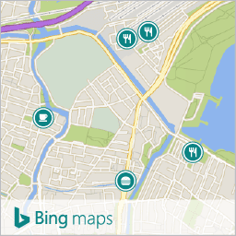

Webmapping Services + Tools
Application Programming Interface (API)
Proprietary Options: One-stop shop for storage/serves, maps & data, and UX
Notes:
API model
API = Application Programming Interface
Provides the interface for interacting with mapping services - basically framework you can use to write a program that help you avoid writing all the low-level code to perform actions.
It is not code itself, but think of it as a set of building blocks you implement when using a language
mediates access to information on the web;
have to build something that requests stuff from the raw service provider > you make a request to the API, it approves the request (based on criteria) and gets the info
Most services on the web use an API model > want to control external access to the bucket of data
Want to pick you API carefully because these are connected to languages and platforms you can use as well as functionality and flexibility
For example there are some commercial/proprietary webmapping services out there,
We have APIs for all of web mapping, but in the case of the proprietary services I laid out here the APIs are built around certain products and functionalities
Proprietary meaning API source code cannot be downloaded or modified, and you can only use it if you pay (in some circumstances)
An example of these can be see in icons below. Lets talk about an example of one of the most popular Google Maps
Web Map Services
The more corporate approach
Use a web map service provider to meet all three of the parts/needs à one-stop shop for storage/servers, maps & data, and UX
Examples: Google Maps, Bing, ESRI Javascript
References for more info:
https://courses.ems.psu.edu/geog585/node/763

Slide 7
Proprietary Webmapping
What do you get?
Map tiles (256 px sq)
Geographic data
Front end controls
Google Maps API
Notes:
So the Google Maps API is part of the Google Maps Platform. Basically this lets you overlay your own data on top of the Google Maps interface
Many popular platforms for real estate (Trulia), Businesses (Yelp), Churches (LDS), etc. use this to create mapping interfaces within their websites
This is great cause it feels familiar to a lot of people since MANY people use google maps all the time
What is the purpose of these and why are they so dominate? What do you get?
Map tiles: where the map comes from;
any interactive map on the web is made up of static images (256 pixels square);
billions of tiles are on a database or server somewhere and your application requests them and they are served to you
Underlying geographic data: when you get tiles, you almost always get data as well;
geographic data – distances between things, street names
Aka. How far are these places
Basic front end (controls, look & feel, etc.): zoom in/out, pan,
layer > you get that provider’s UI and UX > limited options to what it looks like
https://developers.google.com/maps/documentation/tile
https://developers.google.com/maps/documentation/javascript/overview

Slide 8
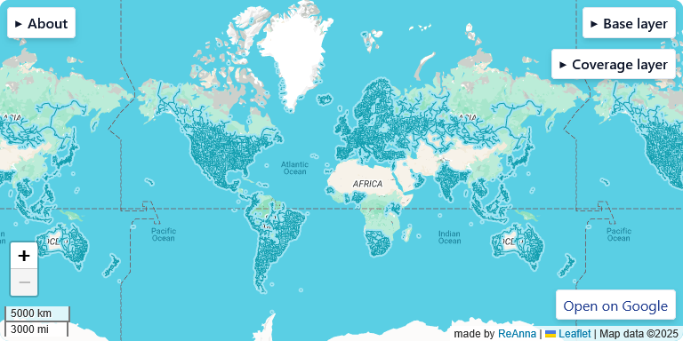
Downsides of Proprietary
No control over look and feel
Proprietary/single source data
Update frequency
Licensing and map call fees (see Google API pricing here)
https://education.openguessr.com/guides/read/beginner/coverage
Notes:
No control over look and feel: no control over the tiles à if you use Google Maps, you get Google Map tiles and they look like Google Map tiles; no control over front end controls
Proprietary/single sourced data: most of them are this (MapQuest less so);
they buy all of their spatial data from a single source and the companies they buy it from are companies’ whose raison d’etre is to create geographic data;
what happens when the single source is crap? à cascading failure
Update frequency: any updates (like new street names and such) take a long time
Problems with (truly) global data:
great fidelity in the West and parts of Asia but many places do not have great fidelity (developing, non-Western, etc.)
places are just empty -> it isn’t in their vested commercial interest to generate the high-fidelity data in those places because their customers weren’t there
this is changing
Licensing/use/map call fees:
most have costs associated with them;
it will cost you money as the developer to use them
Google maps: need a developer account (need to put in a credit card, get a $200 credit). Its free for the first 10,000 but after that every time you do an API call there is a cost ($7/1,000 calls for dynamic and $2/1,000 for static maps, $7/1,000 for static street view, $14/1,000 for dynamic street view)
Basically comes down to if your product is for profit and how many people access it
Mobile is free > deployed solely on mobile device it is free
What is a “Map call”
Map is loaded in an application or webpage using the google maps’ API
Streetview is loaded in an applications or webpage using the google maps API
Single request is made for a map or panorama from the static maps API
Interesting part is that google maps api is free
Why? Data tracking, geographic tracking, pushing people to mobile add service

Slide 9
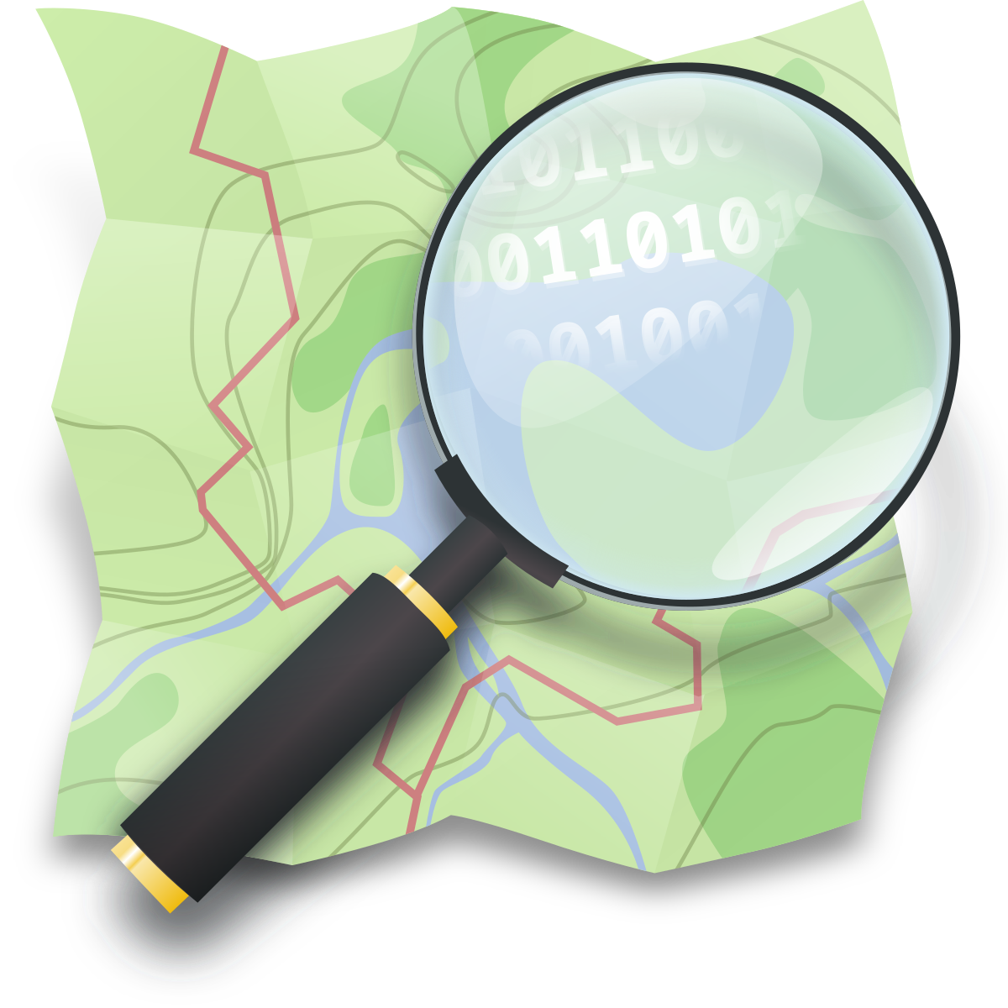


OpenSource Ecosystems
DIY
OpenStreetMap
Front-end - JavaScript
Leaflet JS
GeoJSON
Notes:
How do we solve the proprietary issue?
By taking an Open DIY approach to webmapping - or “fuck it we ball”
What happens is you end up with the same result but its cobbled together instead of using one service provider
You have to get maps (basemap, layers etc), map data, and then built the front-end (javascript - we all know you love it)
Where do you get this?
Map data comes from OpenStreetMap (OSM): The "Wikipedia of maps" - millions of volunteers worldwide map roads, buildings, trails, and points of interest using GPS traces, aerial imagery, and local knowledge. This is what’s used on platforms like Storymap JS because they provide an openly accessible map with data that is crowdsourced.
Why OSM (openstreetmap)?
No licensing/map call costs
They use an ODBL - Open Database License. A license agreement intended to allow users to freely share, modify, and use this Database while maintaining this same freedom for others
User contributed/corrected data
However we could fuck this up; there is a layer that is added that ensures that data is accurate and not political
OSM has an ID editor - you can sign up for an account and you can enhance the map that is presented
OSM has Global data - they prioritized places not well mapped by other institutions and groups, data is maintained and up-to-date
You have complete control over look and feel
For front-end stuff - our friend who we know and LOVE is javascript
This is all the interactive elements
Javascript has mapping libraries - which contain [re-written Javascript to allow for easier development of specific maps
The one we’ll be focused on is Leaflet JS
The most well-established and widely used, the gentlest learning curve (written really well and clearly, complex not complicated; has an enormous community of users and is well-documented)
It is an open-source mapping library and its mobile friendly
Openlayers is another library - runs a little differently, higher learning curve to use
Open-source libraries
Custom data and interactions
The interactive portion is not from the mapping servicers
This part is incredibly project specific - or challenge specific *wink wink*
The fancy stuff is baked right in to html or js
This goes for things like time sliders, pop-ups etc - all of this code can be accessed in the leaflet library
The data for the layers on the other hand is stored in a static file
Generally in a CSV (comma separated values) or a “poor persons database”
The data can be pulled from servers or written by hand
One of the easier ways to store geographic data is in GeoJSON (variant of JSON that specifically encodes geographic data)
Basically it adds geometry or features
{ "type": "Feature", "geometry": { "type": "Point", "coordinates": [-122.4194, 37.7749] }, "properties": { "name": "San Francisco", "population": 873965, "state": "California" } }
Most real world GeoJSON has a collection of features
{ "type": "FeatureCollection", "features": [ { "type": "Feature", "geometry": { "type": "Point", "coordinates": [-122.4194, 37.7749] }, "properties": { "name": "San Francisco", "type": "city" } }, { "type": "Feature", "geometry": { "type": "Point", "coordinates": [-118.2437, 34.0522] }, "properties": { "name": "Los Angeles", "type": "city" } } ] }

Slide 10
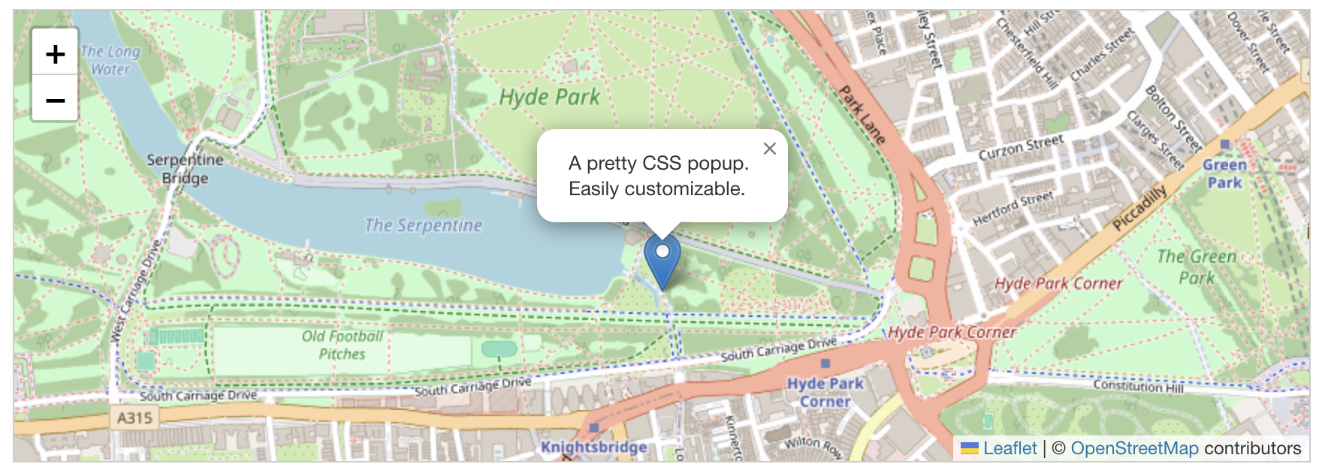
Leaflet JS
https://leafletjs.com/
Notes:
https://docs.google.com/document/d/1BbR25K7w7oRv9y1EXJRJ3mQZdJjFk9meLwu0cJqUcCs/edit?usp=sharing (leaflet code tutorial)
https://docs.google.com/document/d/12Dhq5UbI5MPfMz9pLkttLq0FpjsKSThU75OQpX9zIaw/edit?usp=sharing (markers + popup)

Slide 11
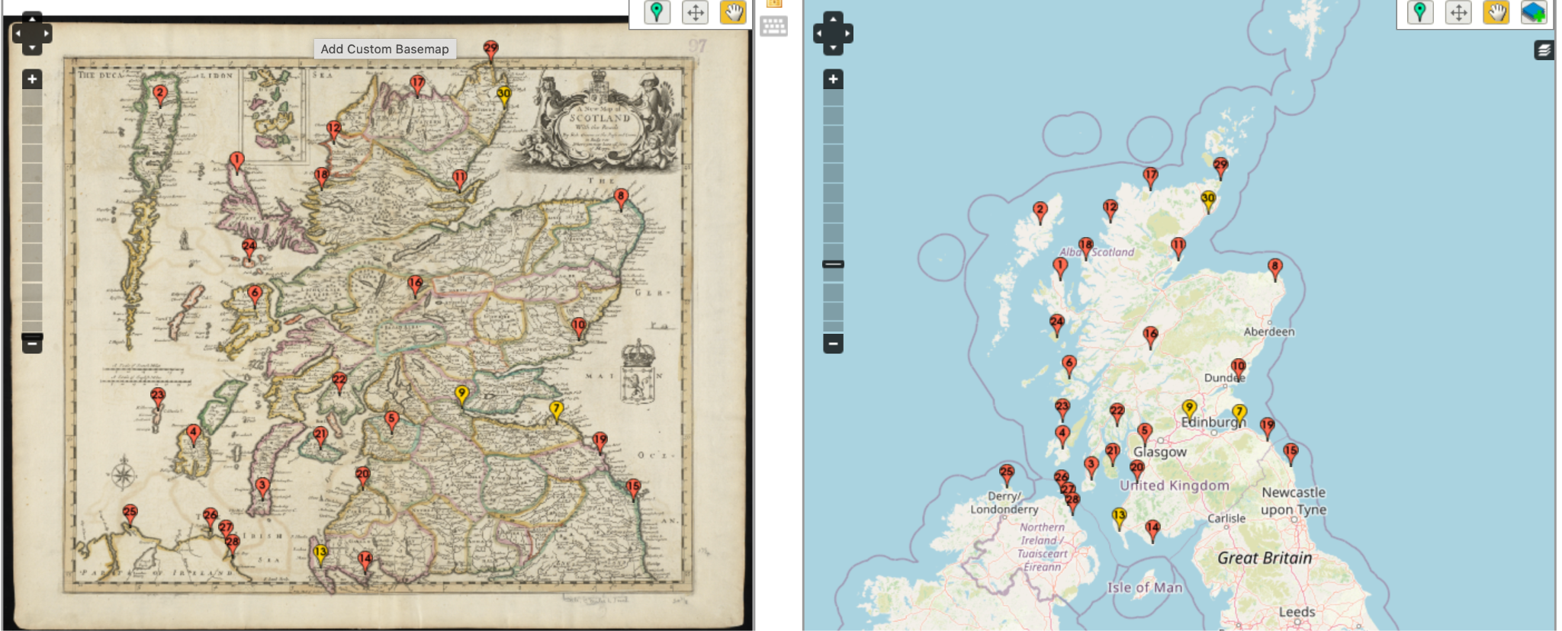
Terminology
Geocoding, Reverse geocoding, Geoparsing, Georectification
Notes:
Some associated terminology that you’ll need to know
Geocoding - the process of finding associated geographic coordinates (often expressed as latitude and longitude) from other geographic data, such as street addresses or ZIP/postal codes
Reverse geocoding - the process of finding an associated textual location such as a street address, from geographic coordinates (Lat/Long, UTM)
Geoparsing - process of assigning geographic identifiers (e.g. geographic coordinates expressed as latitude-longitude) to textual words and phrases that occur in unstructured content
Georectification - the digital alignment of a satellite or aerial image (or digitized map) with a map of the same area

Slide 12
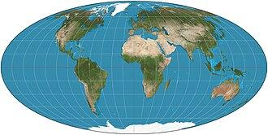
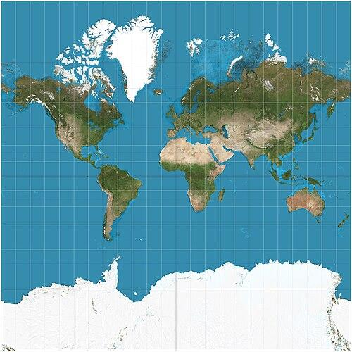
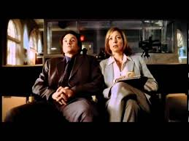
Challenges
Temporal change
Space is cross-cultural, maps are not
Space is contentious
Space is sacred
Space is sensitive
Space is power
https://www.youtube.com/watch?v=eLqC3FNNOaI
Notes:
•Challenges
•Stuff changes over time; most have data for now; mapping historical stuff is different
•Space is cross-cultural: maps present reality; people look at maps and say, “this is how the world is” and that has different effects; maps are a biased statement; maps may not reflect the cross-cultural-ness; naming, colonization and decolonization (see also, space is sacred)
•Space is contentious: creating reality involves debate and contestations; the way space is represented is a statement and may be used to further other goals and aims
•Space is sacred: some people see space as sacred where other people don’t; some naming doesn’t recognize sacredness (some efforts to rename have been successful)
•Space is sensitive: some locations can’t or shouldn’t be listed or published à sensitive data; state archeological records in the US are exempt from FOIA
•Space is power: as statements about reality, maps can be used as a mechanism to enforce or create biased/motivated realities
•Maps are fundamentally colonial: historically speaking, map makers in the 15-17th centuries, the process by which maps were created and the historical context in which they were created were fundamentally tools of colonialism; makes for the construction of interactive web maps more complicated; example, there isn’t a base map tile set that doesn’t have modern nation state boundaries (you have to build your own à ex. Indigenous North America boundaries and such); infrastructure has inherited the inequities and biases of that historical context

Slide 13
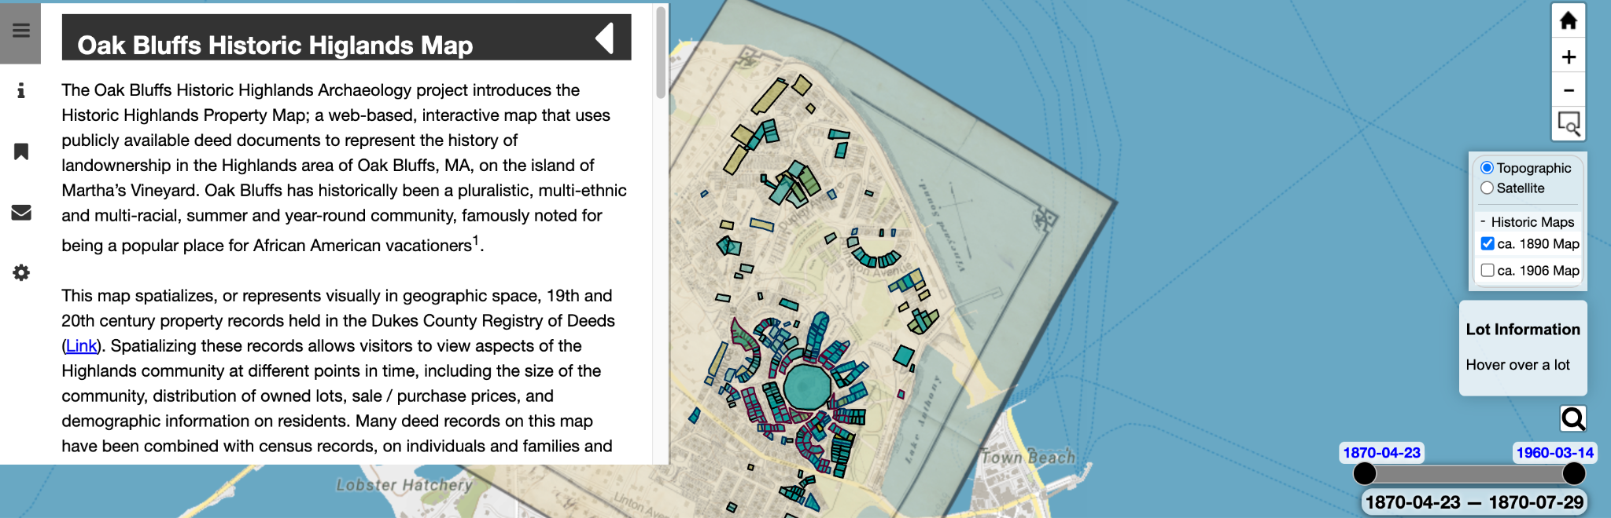
Oak Bluffs Historic Highlands Map
https://historic-highlands.oakbluffsarchaeology.org/

Slide 14
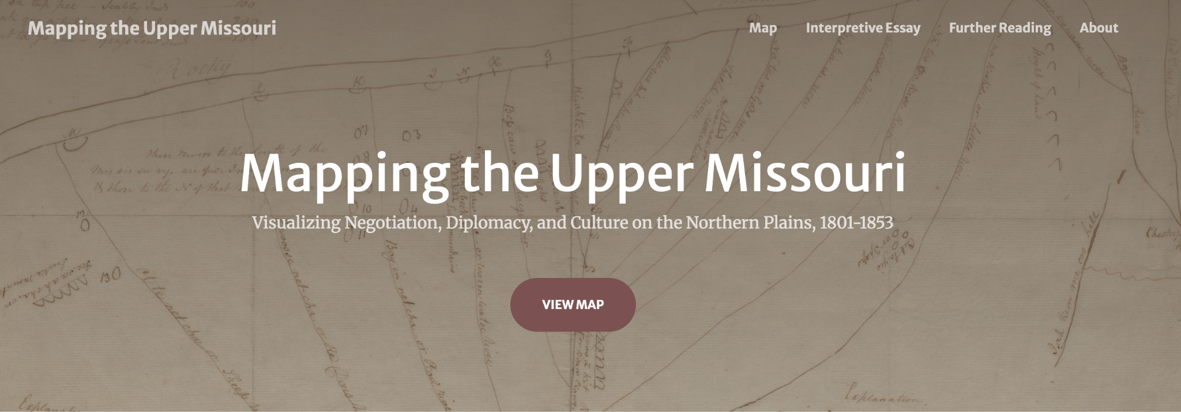
Mapping the Upper Missouri
https://www.mappingtheuppermissouri.com/

Slide 15
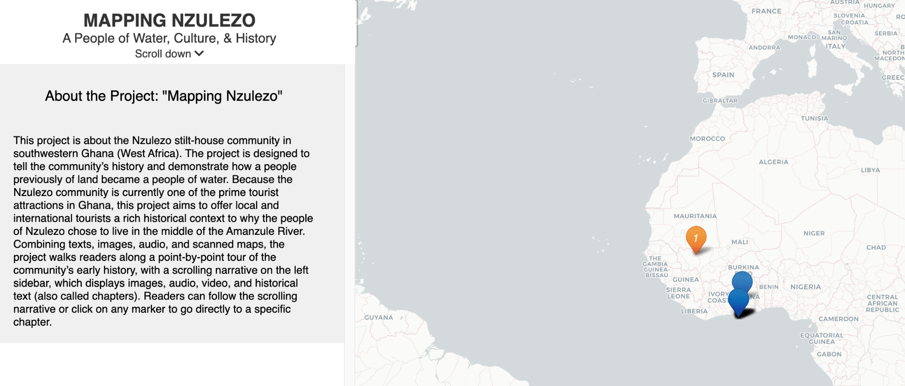
Mapping Nzulezo
https://erickesse.github.io/leaflet-storymaps-with-google-sheets/#1

Slide 16
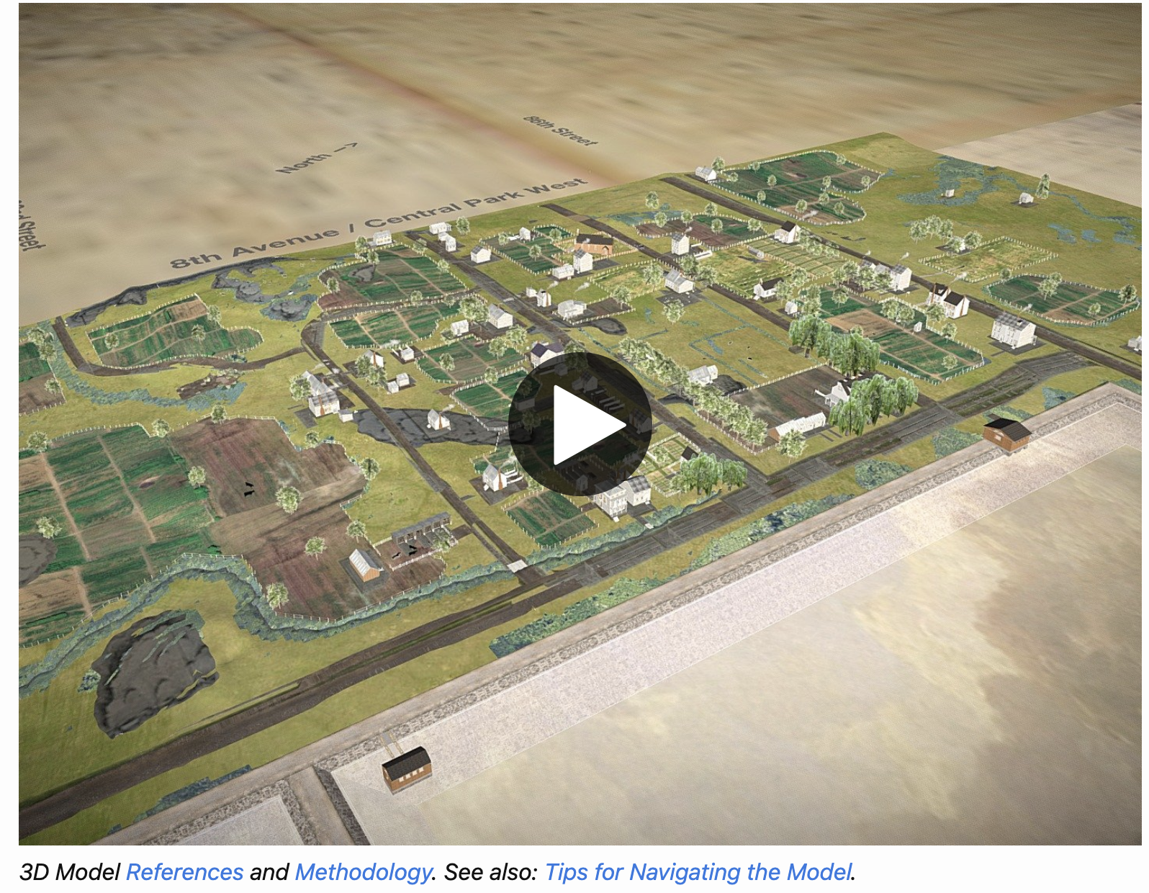
Envisioning Seneca Village
https://envisioningsenecavillage.github.io/

